Slide 1
Retrieval practice and other strategies to improve memory for terminal GCSE’s
Rachel Corcoran-Daldy
daldyr@st-andrews-boys.org.uk
@rcdbazinga

Slide 2
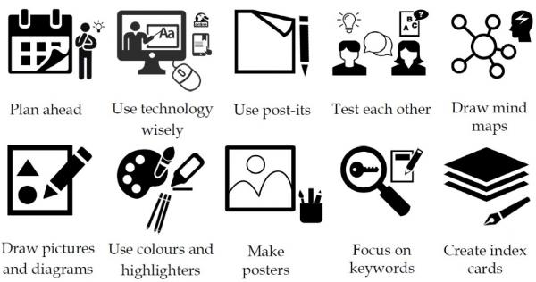
What strategies are you using with your students?
Notes:
Explain the problems caused by terminal exams – retention, retrieval – they understand it in the lesson, but can’t remember it later.

Slide 3
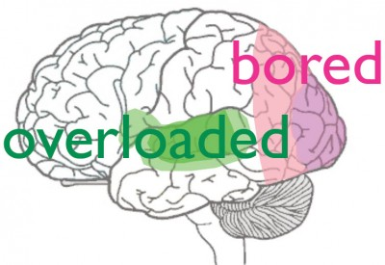
According to research, not all revision techniques are equal…
Bad: ☹
Highlighting & cramming
Good: ☺
Retrieval practice, Spaced practice, lnterleaving, Elaboration, Concrete examples, Dual coding
John Dunlosky, "Strengthening the Student Toolbox: Study Strategies to Boost Learning," American Educator, Fall, 2013. pp 12-21.
Megan Smith & Yana Weinstein, The Learning Scientists: http://www.learningscientists.org/
Notes:
Emphasise how cramming puts only into short-term and is quickly forgotten. When we forget information it is not gone, merely becomes harder to access. Retrieving these memories is something we can get better at with practice.
Latest buzz word is RETRIEVAL PRACTICE which I have been using in my classroom – but it does not stand alone

Slide 4
Retrieval practice – 3 phases
Retrieval practice - e.g. low stakes quiz, fill in the gaps, spot the mistake, etc; best done regularly; include a mixture of topics (interleaving)
Immediate feedback - to avoid misconceptions.
Metacognition - Students should be encouraged to think about their thought processes and how easy it was to recall the information.
http://www.learningscientists.org/
Notes:
Brief description of each stage

Slide 5
Retrieval Practice Challenge Grid:
What are the 3 types of radiation? | How is aluminium extracted from its ore? | How many neutrons in Aluminium? | Why do metals conduct electricity?
What does exothermic mean? | What are the sub-atomic particles? | What acid is reacted with copper oxide to form copper sulfate? | Give two examples of exothermic reactions
How is radiation measured? | How can endothermic reactions be measured? | Why do ionic compounds have high melting points? | How many atoms and elements are in CuSO₄
Example activity
Last lesson (1) | Last week (2) | 2 weeks ago(3) | Further back! (4)
https://www.retrievalpractice.org/
Notes:
This is first lesson with a class. All given a grid to fill in – answer as many as you can (10 mins – work around room to ensure engagement)

Slide 6
REFLECT – Which colour was easiest? Why?
Metacog
Alpha Beta Gamma | Electrolysis (when dissolved in cryolite) | 27-13=14 | Delocalised electrons
Reaction that transfers energy to its surroundings | Protons, neutrons and electrons | Sulfurinc acid | e.g. combustion & Respiration
Using a Geiger-Mueller tube and measured in Becquerels | By recording a drop in temperature using a thermometer. | Giant lattice structure | 6 atoms & 3 elements
Immediate feedback
Last lesson (1) | Last week (2) | Last week (3) | Further back! (4)
https://www.retrievalpractice.org/
Notes:
Marks /30 DID YOU GET 50%? DID YOU GET 6 Questions right which ones & why? How did you remember? (share any tips)
5 finger AfL
Ensure students reflect

Slide 7
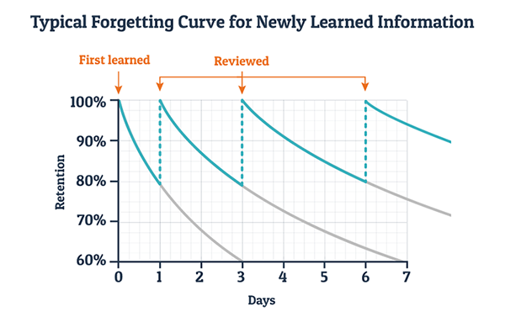
Why retrieval practice (and spaced practice) works…
Ebbinghaus’ (1885) forgetting curve
(repeated Murre & Dros 2015
What can students do?
Practice questions (e.g. past papers, websites etc)
Make flashcards of anything you come across in your revision that you're unsure about (BOX UP regularly!)
Mind maps from memory (correct and add to them after!)
https://en.wikipedia.org/wiki/Forgetting_curve
Notes:
Brief explanation of theory (has been repeated 2015) and EMPOWERING STUDENTS with what they can do! Little and often!! Teaching to lower year groups

Slide 8
Metacognitive strategies
Explicitly teach students metacognitive strategies:
Activating prior knowledge
Explicit strategy instruction
Modelling of learned strategy
Memorisation of learned strategy
Guided practice
Independent practice
Structured reflection – How successful was it? How easy to apply? What situations could it be used in? Why did/didn’t it work?
“Metacognition and self-regulated learning” EEF Guidance report (2018)
Notes:
The EFF guidance report (which brings together a lot of the research) we do this implicitly as teachers
My own practice – increased the frequency that I am modelling skills and how I do it… visualiser, WTM thinking out loud, PLUS the power of reflection. I now try to include this after every new type of task.

Slide 9
Surprising benefits of low stakes testing and retrieval practice:
Students tested on content that they hadn’t previously been tested on did better if they had been used to frequent low stakes tests.
Improves metacognitive monitoring, i.e. students have a more accurate calibration of their knowledge (and any gaps).
Frequency encourages students to study regularly, rather than cram, which improves long-term retention and retrieval
/Roediger, Putneam & Smith (2011)
Notes:
Unusual viewpoint but TEST TEST TEST!! Roediger very influential in the research of testing.

Slide 10
Additional effects observed -
The upshot of these low stakes retrieval quizzes is an increase in student confidence, a willingness to ‘have a go’, plus the ability to skip a question.
/
Notes:
Link in to academic resilience, especially for those lower ability students with poor self-esteem. I have one who now will attempt an answer for all questions – give it his best guess…

Slide 11
Additional strategies employed-
Modelling solutions – WTM and exam technique revision have reduced student panic (as has the knowledge that that ‘rabbit in the headlights’ sensation that is based on their fear of failure only lasts 10 minutes!)
Elaboration (What does this link to? Desirable difficulty)
Concrete examples (e.g. tell a story)
Dual coding (e.g.make a video)
Mind maps & flash cards
/
Notes:
Means that I am not going to be able to measure retrieval practice alone in my research, however all have their merits and are recommended by Dunlosky, the Learning scientists, EFF etc.

Slide 12
Desirable difficulty
“Learning requires an active process of interpretation— that is, mapping new things we are trying to learn onto what we already know….
In short, try to spend less time on the input side and more time on the output side,….
Any activities that…. require you to retrieve or generate information, rather than just representing information to yourself—will make your learning both more durable and flexible.”
Bjork & Bjork (2011) pp 62-63
Notes:
Reinforces the idea of challenge in order to build on current understanding and make connections to form lasting, retrievable memories. Link to Gagne & White’s memory episodes

Slide 13
How has this research changed my practice:
Explicitly modelling and teaching revision strategies and allowing for metacognitive reflection (questioning)
Incorporating Retrieval activities within SoW
Focus on exam technique to increase student resilience
What I’m going to try next:
Retrieve taking – make notes AFTER the video rather than during. Traditionally I have championed making mind maps during videos etc, and then asking students to ‘write them up’.
Negative marking (to reduce threat)
https://www.retrievalpractice.org/archive/2018/5/11/retrieve-taking

Slide 14
Further info & resources
Roediger, Putnam & Smith (2011) ‘Ten benefits of testing and their applications to educational practice’, Psychology of Learning and Motivation, Vol 55, pp1-36
“Metacognition and Self-Regulated learning”, Guidance report – Education Endowment Foundation (2018)
Gagné, R. and White, R. (1978) Memory Structures and Learning Outcomes, Review of Educational Research, 48(2), pp. 187-222.
White, R. T. (1996) The link between the laboratory and learning. International Journal of Science Education, 18(7), pp. 761-774.
Bjork & Bjork, ‘Making things hard on yourself, but in a good way; Creating desirable difficulties to enhance learning’, in Gernsbacher et al (eds.) Psychology and the real world:Essays illustrating fundamental contributions to society (2nd edn) pp59-68, 2011
John Dunlosky, "Strengthening the Student Toolbox: Study Strategies to Boost Learning," American Educator, Fall, 2013. pp 12-21.
Megan Smith & Yana Weinstein, The Learning Scientists: http://www.learningscientists.org/
https://www.retrievalpractice.org/
https://www.innerdrive.co.uk/
Notes:
sources

Slide 15
Let me know what is/isn’t working for you…
"If you could choose only one thing from this session you want to remember in 10 years, what would it be and why?"
Rachel Corcoran-Daldy
daldyr@st-andrews-boys.org.uk
@rcdbazinga

