Slide 1
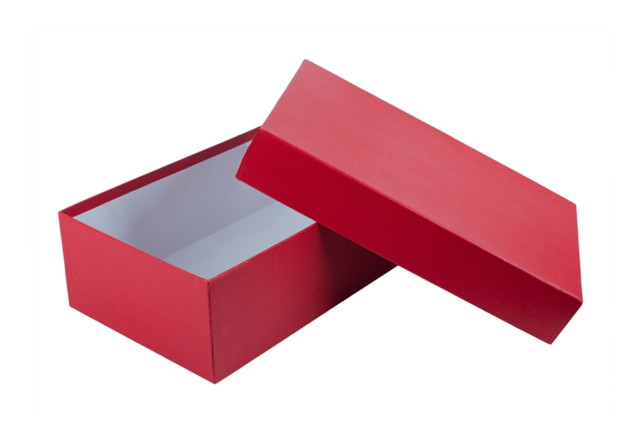
Lessons in a shoe box – a simple tool for extending the G&T student
Have you ever had seen gifted and talented students finish their work quickly with ease? Then, for their extension task given more of the same questions or problems to solve?
In which case, this presentation aims to give practical ideas which can be used to extend the learning of gifted and talented students, or provide an incentive for students making rapid progress to try something different.
Notes:
Not ‘thinking outside the box’, but instead ‘thinking inside the box’!

Slide 2
The ‘why?’ And the ‘how?’
Why? At SPH our SEND team carried out research and asked G&T pupils what engaged them in lessons:
Choice
Creativity
Present/teach ideas/findings to others
Challenge
Problem solving
How?
Laminated instructions for the task
List of contents for each box
Register for pupils completing each box
Get you and your department to come up with 2 or 3 boxes each and share them between your teaching spaces/swop over termly

Slide 3
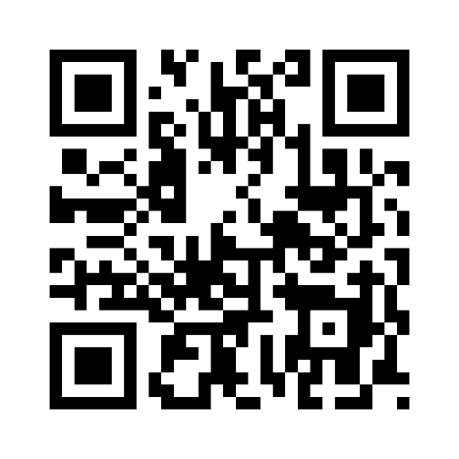
Ideas for other curriculum areas?
Geography – map and compass which directions to navigate
Art – two pictures/sculptures to compare and contrast
English – a poem or passage of unusual text to analyse
Maths – 3D puzzles, problem to solve, riddles etc
History – a piece of evidence to a time in history
Note: it could just be a QR code with a link to a video clip they could watch on their phones:

